Slide 1
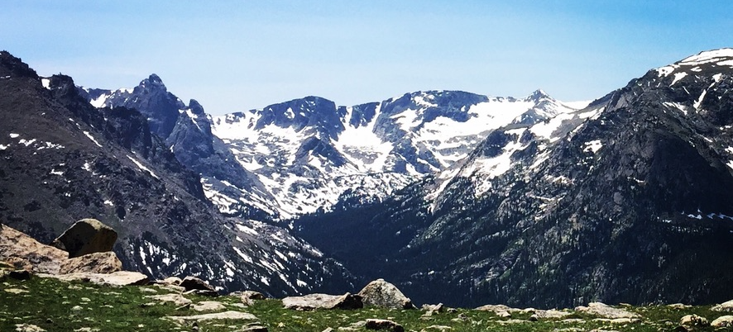
Fitting a model to data
UNM Earth Sciences Computing & Programming Experience
Aug 8 – 19, 2022
Instructors:
Eric Lindsey, Lindsay Worthington, Brandon Schmandt, Mousumi Roy, Jeng Hann Chong, Evans Onyango

Slide 2
Matrix shapes
We describe matrix shape as (number of rows) x (number of columns)
For example, a matrix with 3 rows and 2 columns would be a ‘3x2 matrix’
In Python, you would get the size of matrix A using
(rows, cols) = np.shape(A)

Slide 3
Matrix addition and subtraction
To add two matrices is easy. Just add the corresponding numbers in each row/column.
For this to be possible, the matrices need to be the same size. The result is also the same size.
In Python, you can add the matrices by simply using the ‘+’ sign.

Slide 4
Matrix multiplication by a single number
To multiply a matrix by a single number, just multiply every element in the matrix by that number.
In Python, this would just be
B = A*2

Slide 5
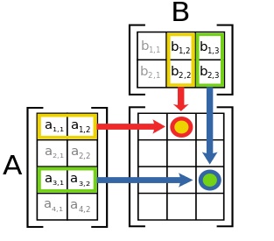
Matrix multiplication
This is more complicated than addition and subtraction!
We do NOT just multiply together the corresponding rows and columns.
Instead, we take product for each row and column and add them up.
For example,
c₁₂ = a₁₁*b₁₂ + a₁₂*b₂₂
In Python, use
C = np.matmul(A,B)
C

Slide 6
Matrix multiplication – why do we do it like this?
Here’s an example:
A canteen stall sells three dishes: chicken rice, curry puff, and laksa. (With this mixture, we can guess the food is not very good! ☺)
These are their prices per plate:
Dish | Price
Chicken rice | $3
Curry puff | $1
Laksa | $5
This is how many plates they sold in the last few days:
 | Chicken rice | Curry Puff | Laksa
Monday | 20 | 25 | 15
Tuesday | 30 | 25 | 20
Wednesday | 10 | 20 | 15

Slide 7
Matrix multiplication – why do we do it like this?
They’d like to know how much they earned each day. We can calculate it by
Monday = (20*$3) + (25*$1) + (15*$5) = $160
Tuesday = (30*$3) + (25*$1) + (20*$5) = $215
Wednesday = Class exercise.
Can you see where we’re going with this?
 | Chicken rice | Curry Puff | Laksa
Monday | 20 | 25 | 15
Tuesday | 30 | 25 | 20
Wednesday | 10 | 20 | 15
Dish | Price
Chicken rice | $3
Curry puff | $1
Laksa | $5

Slide 8
Matrix multiplication – why do we do it like this?
Here’s how to do it with matrix multiplication:
 | Chicken rice | Curry Puff | Laksa
Monday | 20 | 25 | 15
Tuesday | 30 | 25 | 20
Wednesday | 10 | 20 | 15
Dish | Price
Chicken rice | $3
Curry puff | $1
Laksa | $5

Slide 9
Matrix multiplication, continued
To be able to multiply two matrices, the number of columns from the first needs to be the same as the number of rows from the second.
The resulting matrix have the number of rows of the first matrix, and the number of columns of the second matrix.
- This would work: (2x3) x (3x2) - This would not work: (2x3) x (2x2)
Class exercise:
- Can I multiply a (4x5) matrix by another (4x5) matrix?
- How big would the resulting matrices be for the examples above?

Slide 10
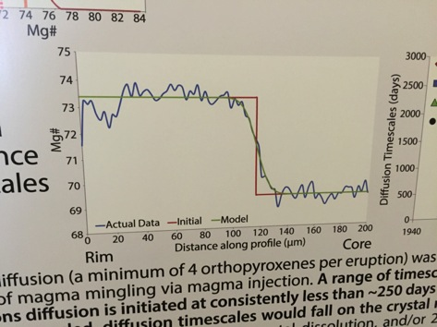
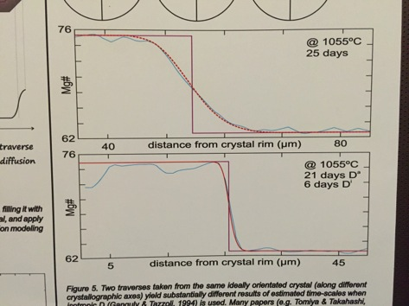
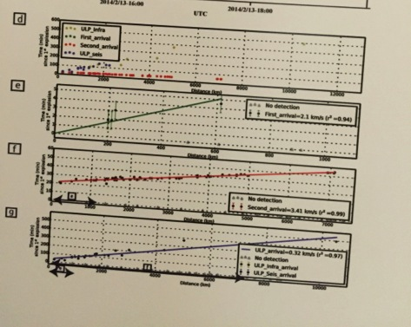
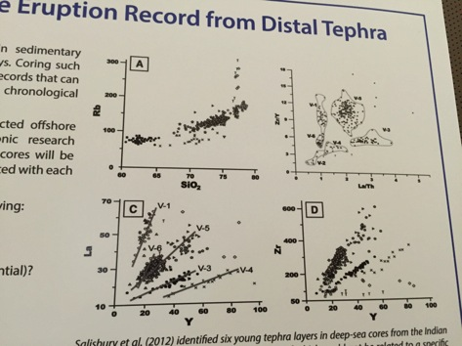
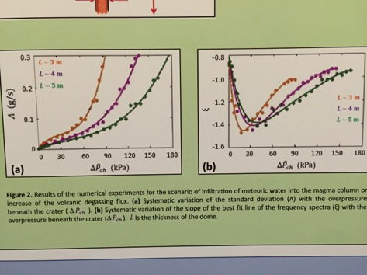
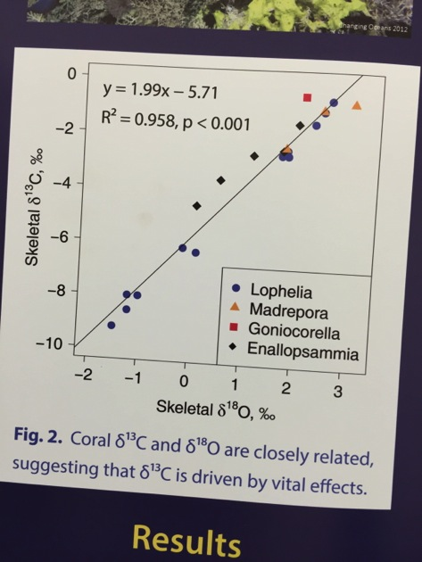
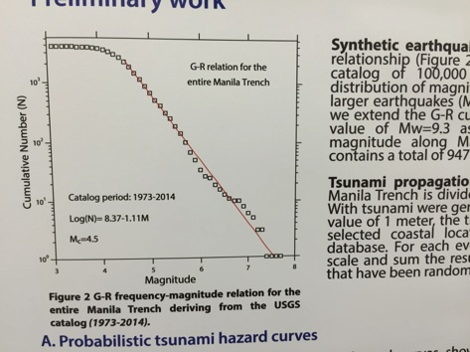
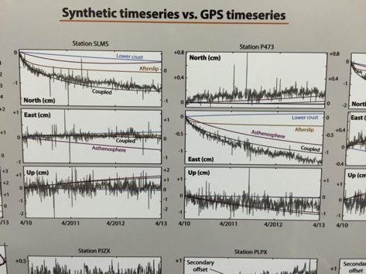

Slide 11
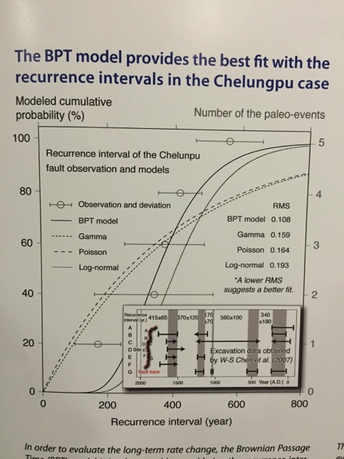
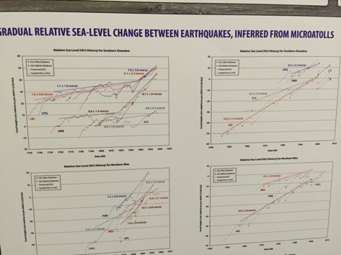
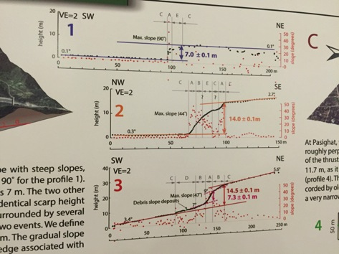
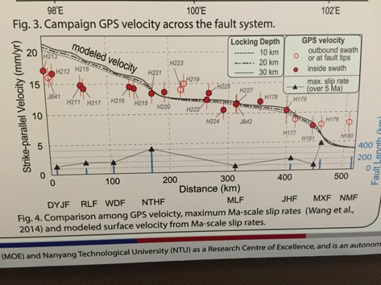
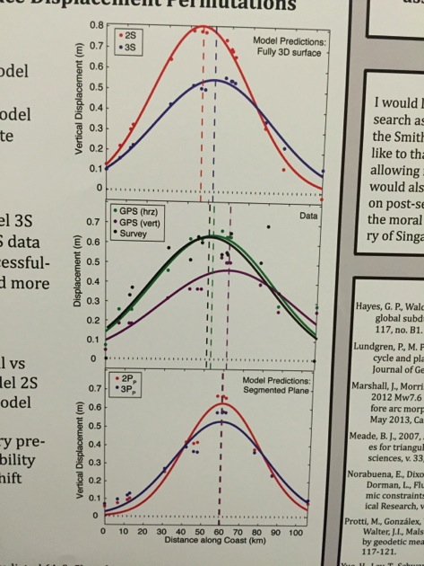
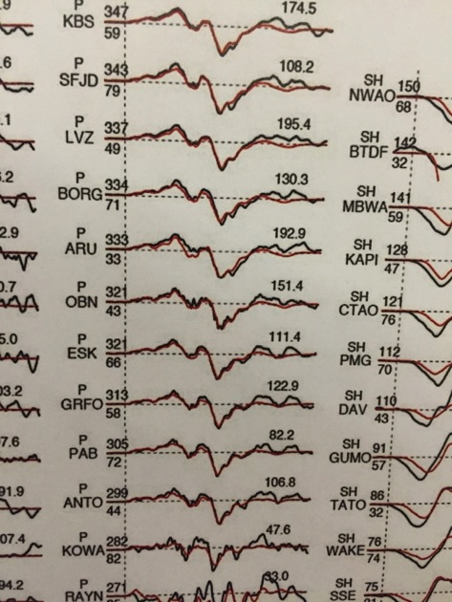
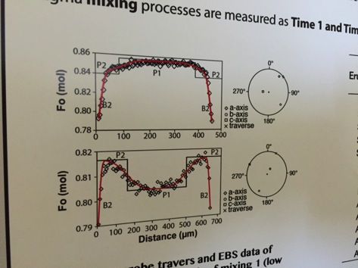
These posters could be summarized as follows:
-> Find the best set of parameters to explain the data with a model

Slide 12
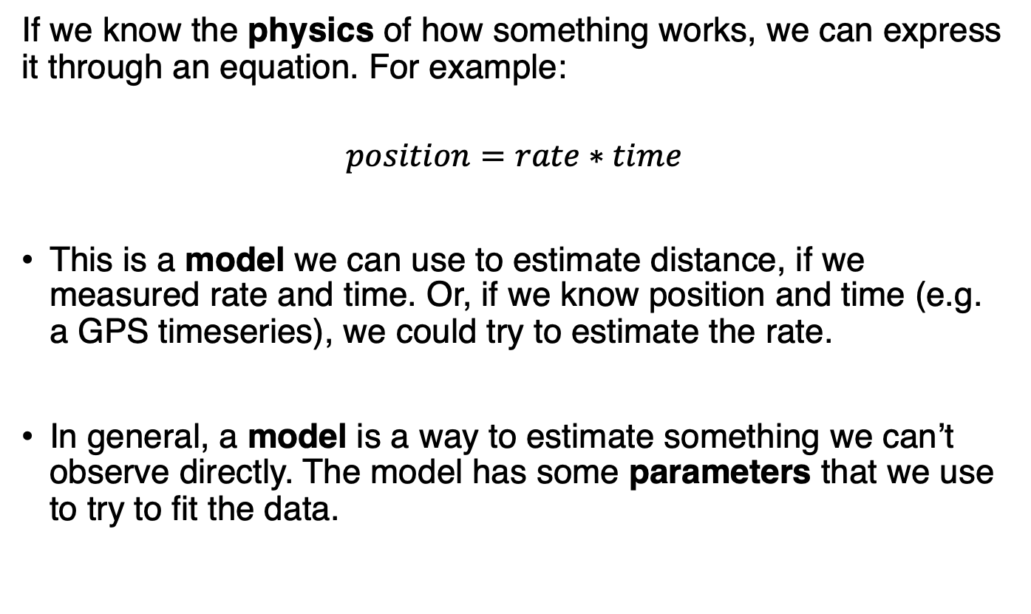
What is a model?
If we know the physics of how something works, we can express it through an equation. For example:
$$position=rate∗time$$
This is a model we can use to estimate distance, if we measured rate and time. Or, if we know position and time (e.g. a GPS timeseries), we could try to estimate the rate.
In general, a model is a way to estimate something we can’t observe directly. The model has some parameters that we use to try to fit the data.

Slide 13
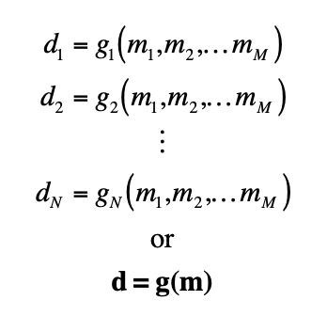
Models, data, and model parameters
We analyze data to infer the values of model parameters. The inference is possible because the data and model parameters are linked through some kind of quantitative model.
The vector d contains the data, and the vector m contains model
parameters. The function g(m) relates the two.

Slide 14
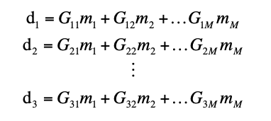
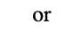
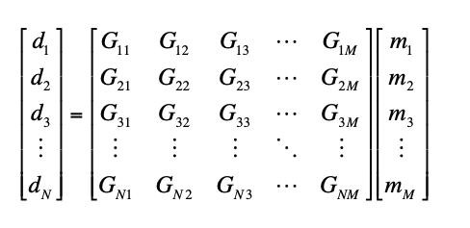
Models, data, and model parameters - linear case
In many cases, the model is linear: so we can write it as a matrix.

Slide 15
Forward and Inverse models
If the model parameters are known, then the data values can be predicted using a forward model.
d = G*m
If we have data and want to estimate the model parameters, we solve the following as an inverse model.
dobs = G * mest
or
mest = G⁻¹ * dobs

Slide 16
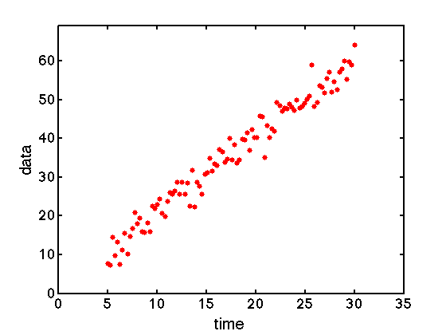
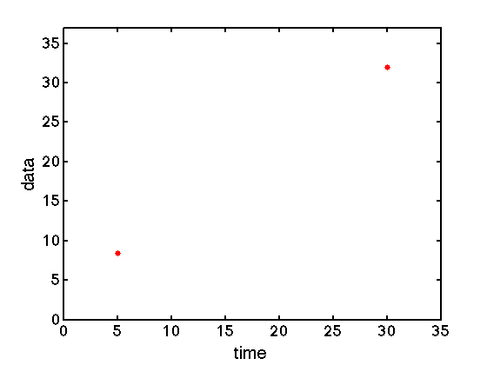
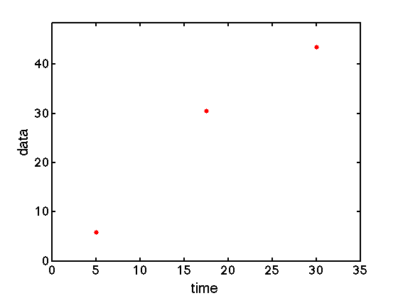
Find the best linear fit for the following plots (draw by eye):

Slide 17
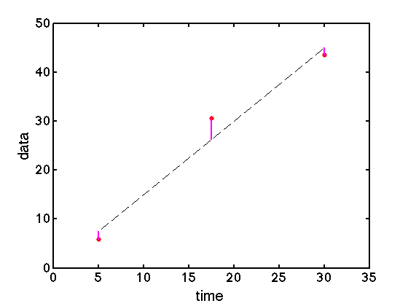
How do we find the best fit?
error_{i}
d_{i}^{observed}
We are mentally trying to minimize the difference between the data and the model. Humans are actually very good at this!
d_{i}^{predicted}

Slide 18
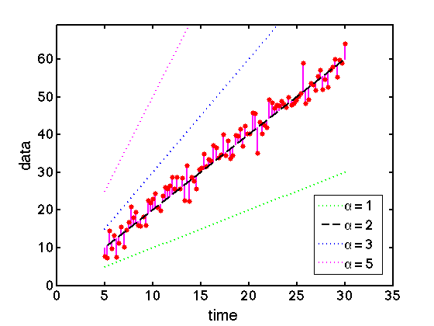
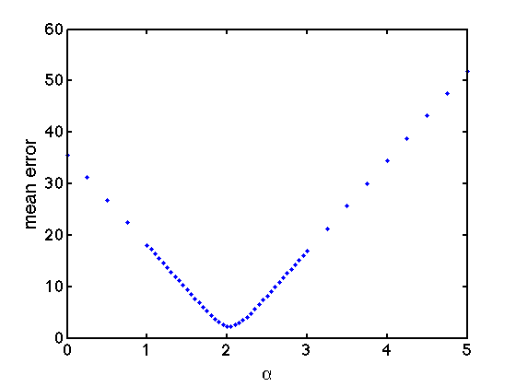
How do we find the best fit?
We could calculate the error for a lot of possible lines:
Tedious… Isn’t it?
Let us have the computer do it for us!
Minimum error = Best value

Slide 19
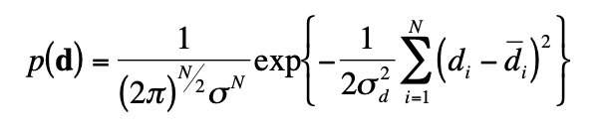
One-slide “derivation” of Least Squares
For uncorrelated gaussian noise, the probability distribution function (PDF) for the data is given by a multivariate Normal distribution:

Slide 20
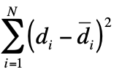
One-slide “derivation” of Least Squares
For uncorrelated gaussian noise statistics, the probability distribution function (PDF) for the data is given by a multivariate Normal distribution:
The maximum of this PDF will occur at the minimum of:
Which is just the sum of the square of the errors.
See your statistics textbooks for a slightly longer full derivation. For us, it’s enough to remember that we are assuming Gaussian noise anytime we use least squares.

Slide 21
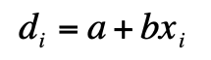
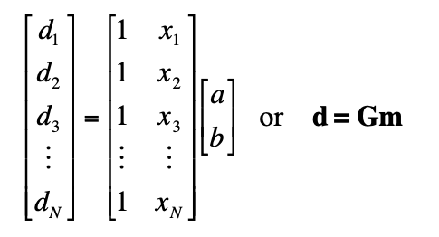
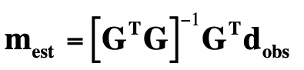
Writing the model for the computer to understand
We guess that the data is fit by the following “observation equation”:
The model parameters are a and b.
As a matrix:
** Technical terms: the columns of the design matrix are the partial derivatives of the observation equation, with respect to the model parameters.

Slide 22
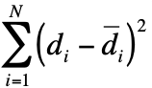
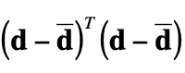
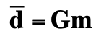
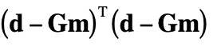
How to use least squares?
We want to minimize the sum of the square of the errors.
We assume that the model represents the data mean:
Then we want the model m that minimizes:
Solving for m, we obtain

Slide 23
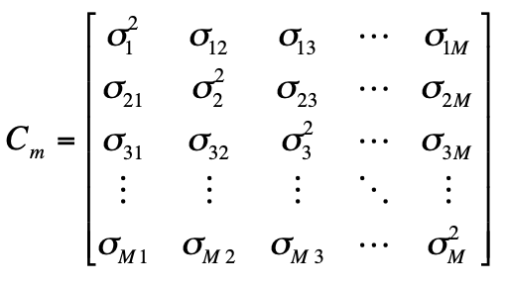
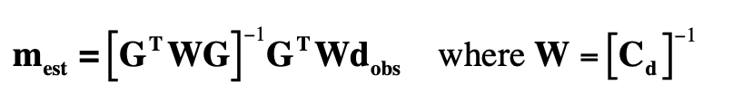
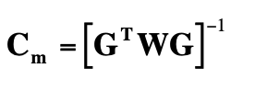
Generalized least squares
If the uncertainty/noise in our data is uniform, we can use standard least squares to estimate our model parameters:
If there is some variable noise in the data, we should express it as a covariance matrix:
Then we can estimate the model via:
And an estimate of the model covariance is given by:

Slide 24
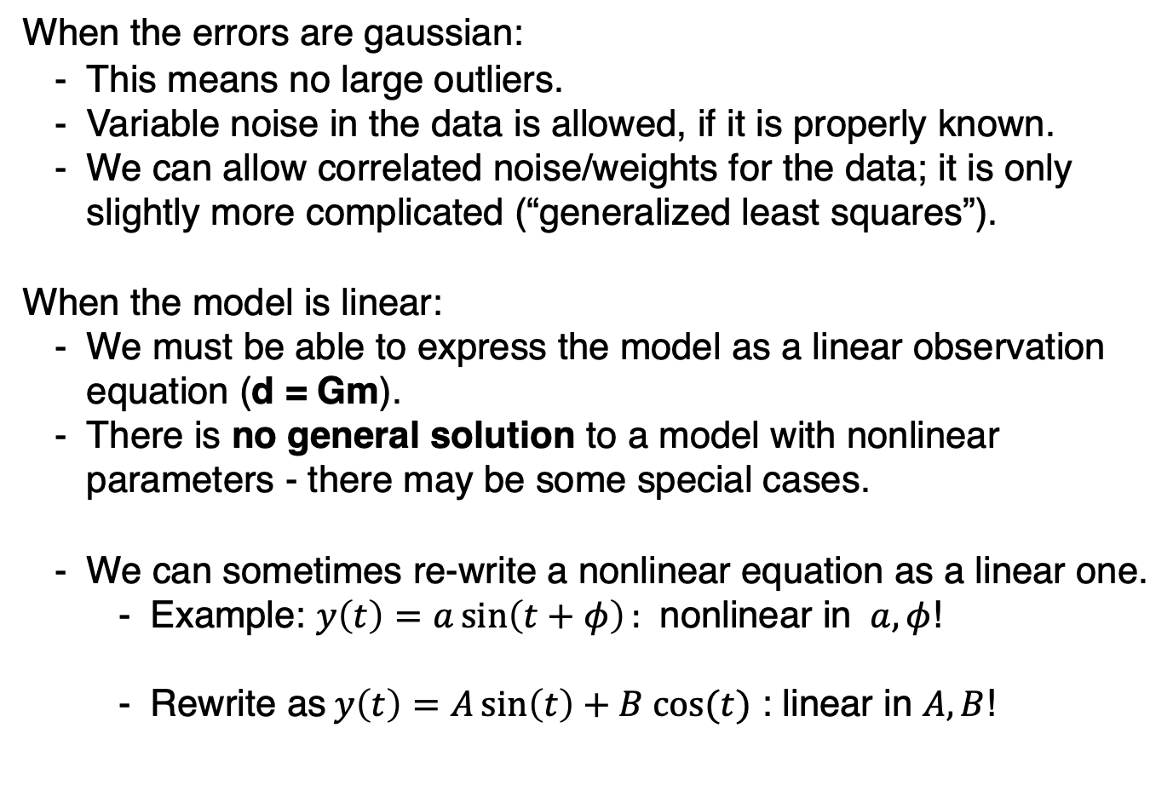
When can I use least squares?
When the errors are gaussian:
This means no large outliers.
Variable noise in the data is allowed, if it is properly known.
We can allow correlated noise/weights for the data; it is only slightly more complicated (“generalized least squares”).
When the model is linear:
We must be able to express the model as a linear observation equation (d = Gm).
There is no general solution to a model with nonlinear parameters - there may be some special cases.
We can sometimes re-write a nonlinear equation as a linear one.
Example: $y\left(t\right)=a\sin\left(t+φ\right):$ nonlinear in $a, φ$!
Rewrite as $y\left(t\right)=A\sin\left(t\right)+B cos⁡(t)$ : linear in $A,B$!

Slide 25
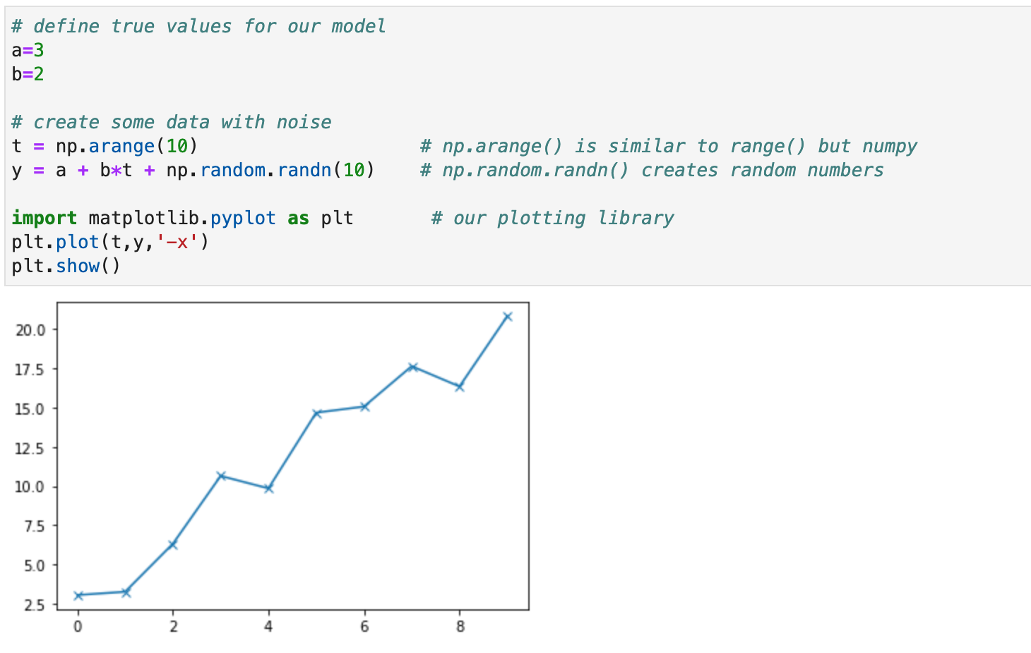
Least squares in the computer
Let’s get some data:

Slide 26
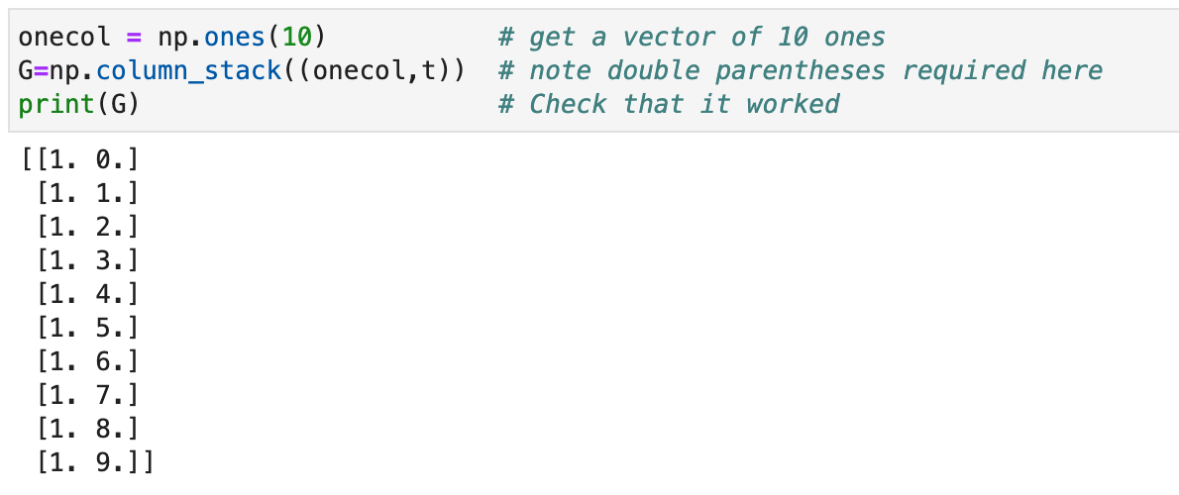
Least squares in the computer
Set up the matrices:

Slide 27
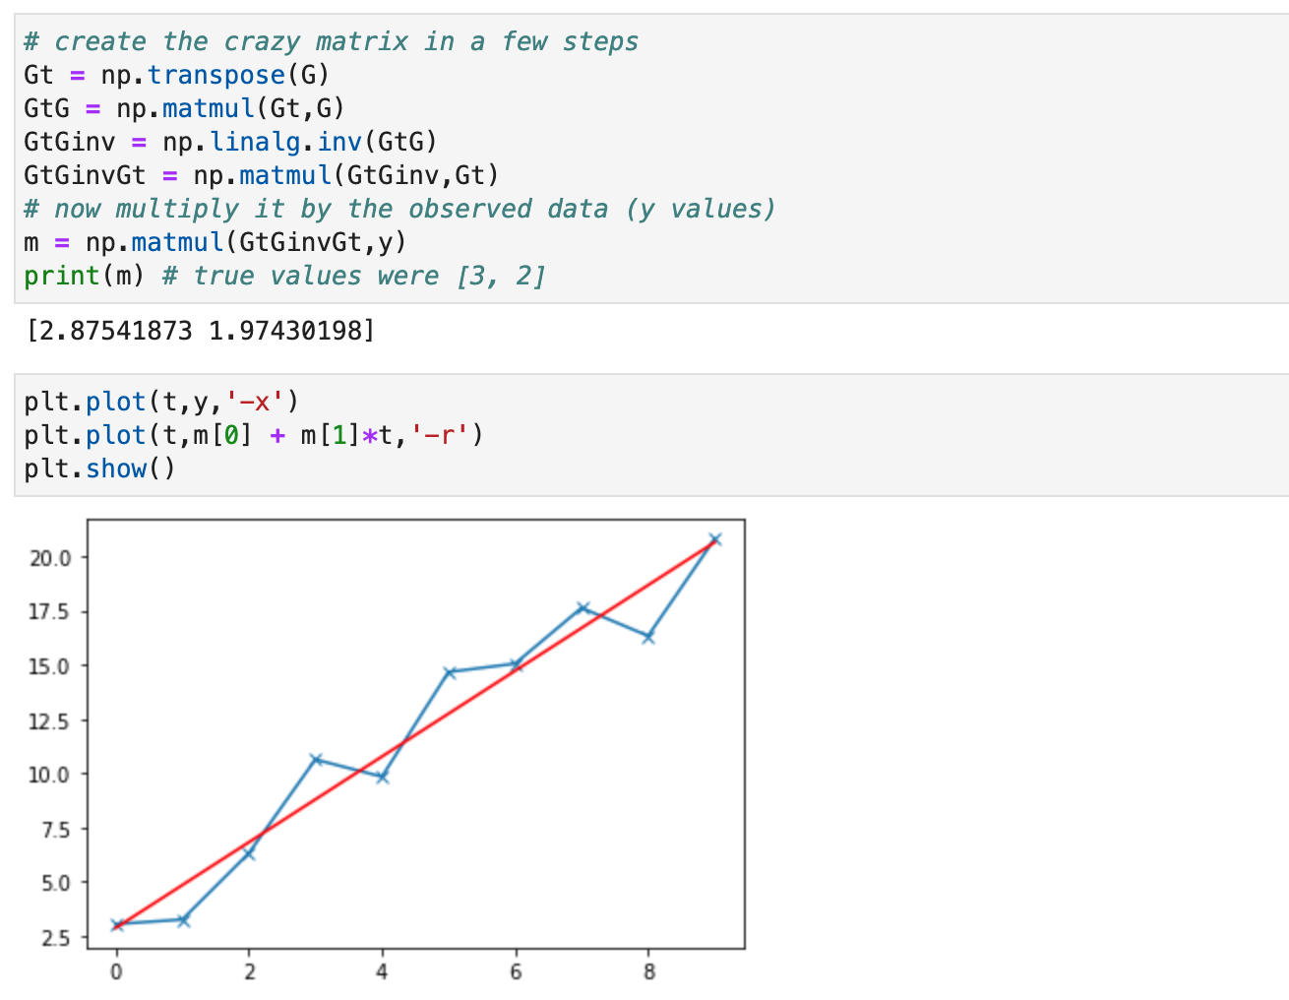
Least squares in the computer
Find the best fit, using

Slide 28
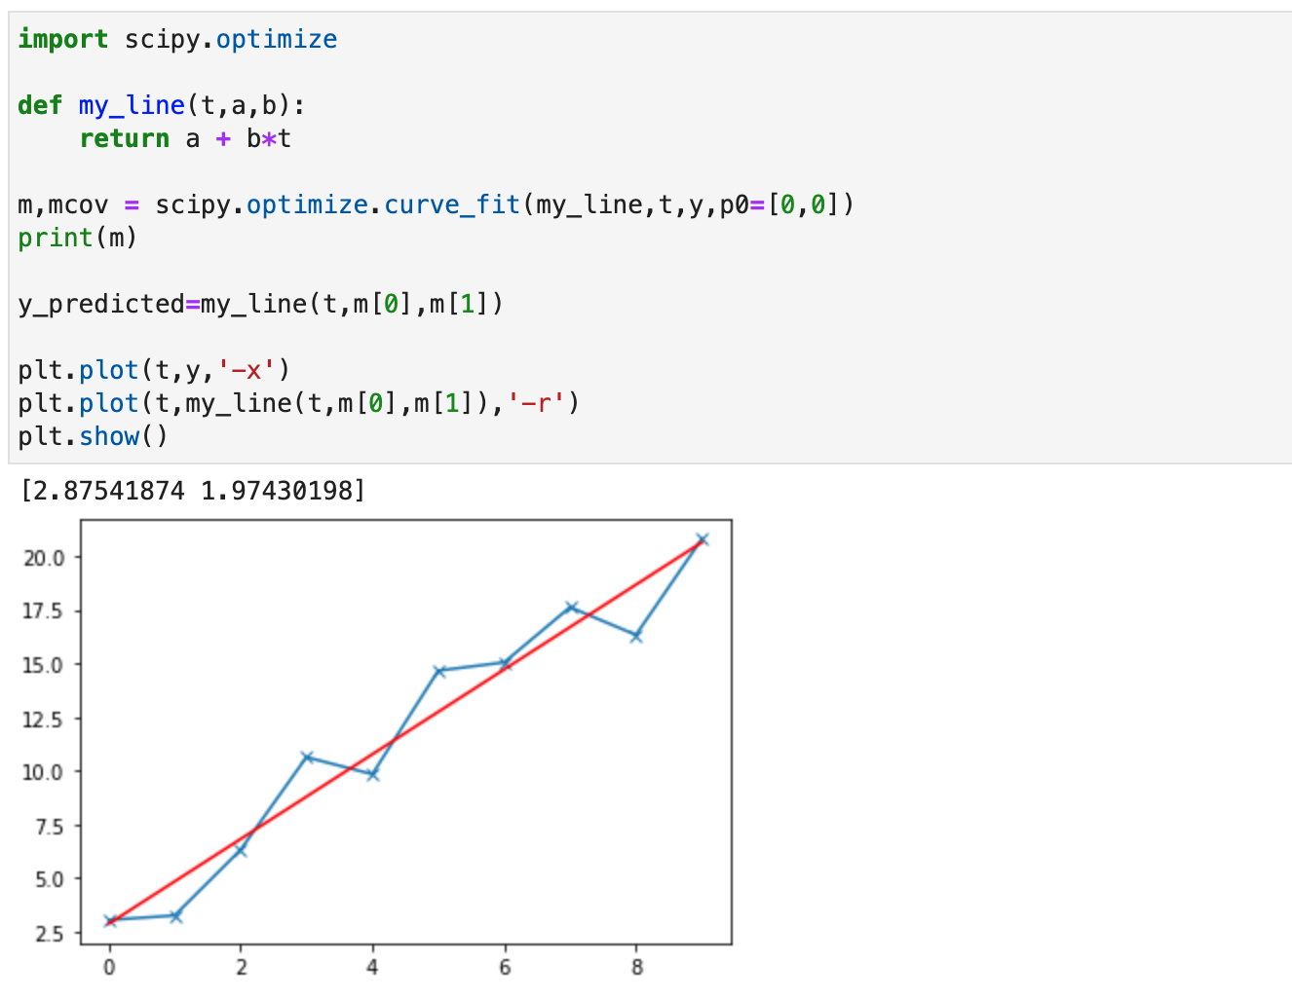

A more powerful way, with scipy
Scipy is “scientific python” and has tons of amazing functions. For example, scipy.optimize.curve_fit().

